Slide 1



Analyzing the impact of lifestyle on heart disease using data analytics
Presentation by: -
Atlantik Chaudhary
Supriya Peetani

Slide 2



Introduction
Objective
Lifestyle Factors
About Dataset
Data Understanding
Data Visualization
Conclusion

Slide 3




Introduction
Heart disease, or cardiovascular disease, refers to various conditions affecting the heart and blood vessels. The most common type is coronary artery disease (CAD), which occurs when arteries supplying the heart become narrowed or blocked, often leading to chest pain or heart attacks. Other forms include heart failure (when the heart can't pump blood effectively), arrhythmias (irregular heartbeats), congenital heart defects (present at birth), and valvular heart disease (issues with heart valv
Major risk factors include high blood pressure, high cholesterol, smoking, obesity, diabetes, lack of exercise, and poor diet. Symptoms can include chest pain, shortness of breath, fatigue, or swelling in the legs. Prevention involves a healthy lifestyle, regular exercise, a balanced diet, and avoiding tobacco. Early diagnosis and treatment are crucial to managing heart disease and preventing serious complications like heart attacks or stroke.

Slide 4



Objective
The primary objective of addressing heart disease is to reduce its prevalence, associated mortality, and improve overall cardiovascular health through prevention, early detection, and effective management strategies.
Key Objectives in Combating Heart Disease
Preventing Heart Disease and Stroke
Improving Cardiovascular Health in Adults
Reducing Coronary Heart Disease Deaths
Addressing Health Disparities
Promoting Healthy Lifestyles

Slide 5



Lifestyle factors
Lifestyle factors like diet, physical activity, smoking, and stress significantly impact heart disease risk. An unhealthy diet high in saturated fats, sodium, and cholesterol, lack of regular exercise, smoking, and chronic stress can increase the chances of developing heart conditions. Conversely, a heart-healthy diet, regular physical activity, quitting smoking, and managing stress can help reduce the risk of heart disease.
Diet
Physical Activity
Smoking
Stress
Other Factor

Slide 6
About Dataset
The dataset described in the heart.csv file seems to relate to heart disease analysis based on several medical and physiological attributes. This type of dataset is typically utilized in healthcare analytics to study risk factors for cardiovascular. The dataset usually contains features such as age, sex, chest pain type, resting blood pressure, cholesterol, fasting blood sugar, resting electrocardiographic results, maximum heart rate achieved, exercise-induced angina, and ST depression induced by exercise, along with a target variable that indicates whether or not the patient is suffering from heart disease. Analyzing the dataset through data analytics will provide vital information about the patterns and correlations among these attributes and their influence on heart disease. For example, Visualization analysis may indicate whether high cholesterol and abnormal ECG readings are more often associated with the presence of heart disease. Visualization tools provide the users with a very clear understanding of the trends detected, such as histograms, boxplot, and heatmaps.

Slide 7

Overview Dataset
The dataset contains 1,025 entries and 14 columns, including these key features:
age, sex: Demographics
cp (chest pain type), trestbps (resting blood pressure), chol (cholesterol)
fbs (fasting blood sugar), restecg (resting ECG), thalach (max heart rate)
exang (exercise-induced angina) → lifestyle indicator
oldpeak (ST depression induced by exercise), slope, ca, thal
target: Heart disease presence (1 = yes, 0 = no)
Potential Lifestyle-Related Features:
exang (exercise-induced angina)
fbs (fasting blood sugar, diet-related)
chol (cholesterol level, diet/lifestyle-related)
thalach (heart rate response to exercise)
oldpeak (related to exercise response)

Slide 8

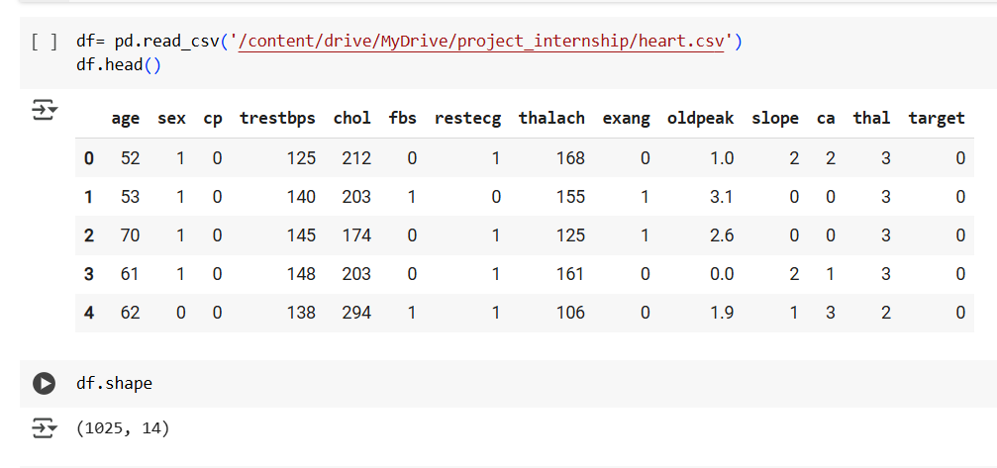
Data Understanding

Slide 9
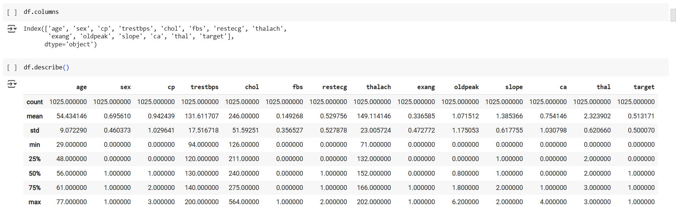

Slide 10
In the above first picture:(page: 9) there is some code regarding columns which show the columns name of the dataset. In the second picture there are statistical summary of dataset where we can see the value that indicate the different value of each columns such as count, mean, standard deviation (STD), minimum value (min), first quartile (25%), second quartile (50%) and last quartile (75%), along with maximum value (max). This image contains clinical and demographical data from the data set which have 1,025 patient with 14 features. Some of the key points of the dataset are that the target variable is balanced at 51% cases of heart disease, with average cholesterol levels being high (246 mg/dL) and resting blood pressure being 131.6 mmHg. Outcomes outliers are high cholesterol values (up to 564 mg/dL) and an impossible value for "ca" (4 vessels). The factors established by the data constitute a male majority (70%) and presence of ischemia induced by exercise (mean of ST depression = 1.07). Cleaning such data for outliers, inconsistent encodings, and skewed distributions is a must for sturdy predictive modelling.

Slide 11
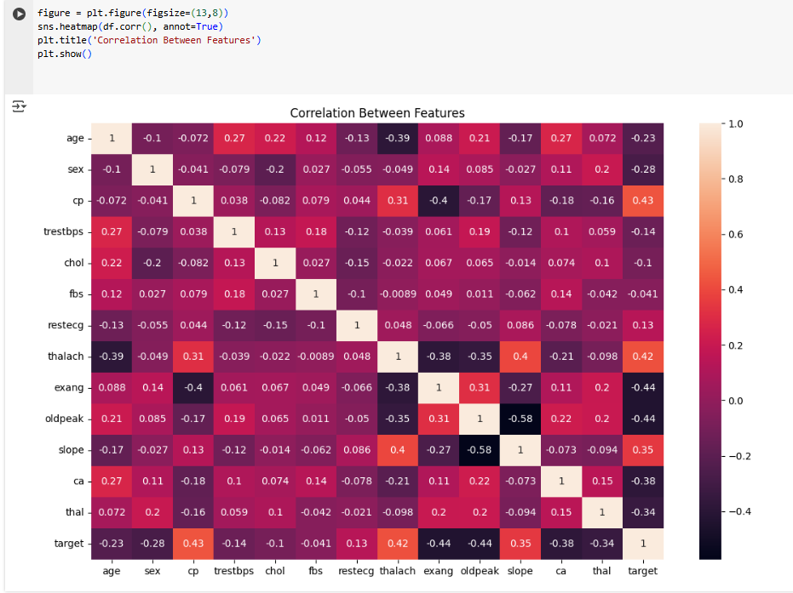
Correlation between Features

Slide 12
In the given above figure show the correlation between the various features where we can see the value between 1 to -1 range. if there is 1 (one) that mean perfect correlation where other feature also increase too and -1 indicate negative correlation between the feature where other features decrease too. And 0 (zero) indicate there is no correlation between the any feature of dataset. This visualization show help in identifying important relationship among various health indictor, guide further statistical analysis and feature selection for predictive modelling in healthcare analytics. Ultimately, this correlation matrix is important for understanding the complex interdependencies among variable in medical datasets.

Slide 13
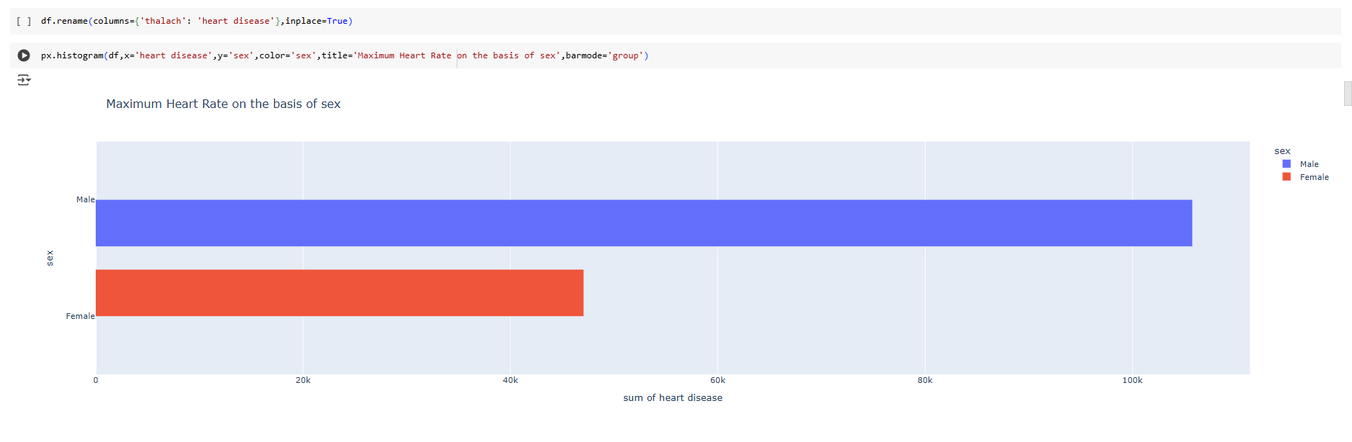
In the above figure we can indicate that comparing between female and male, Male are more affect by Heart Disease then female.

Slide 14
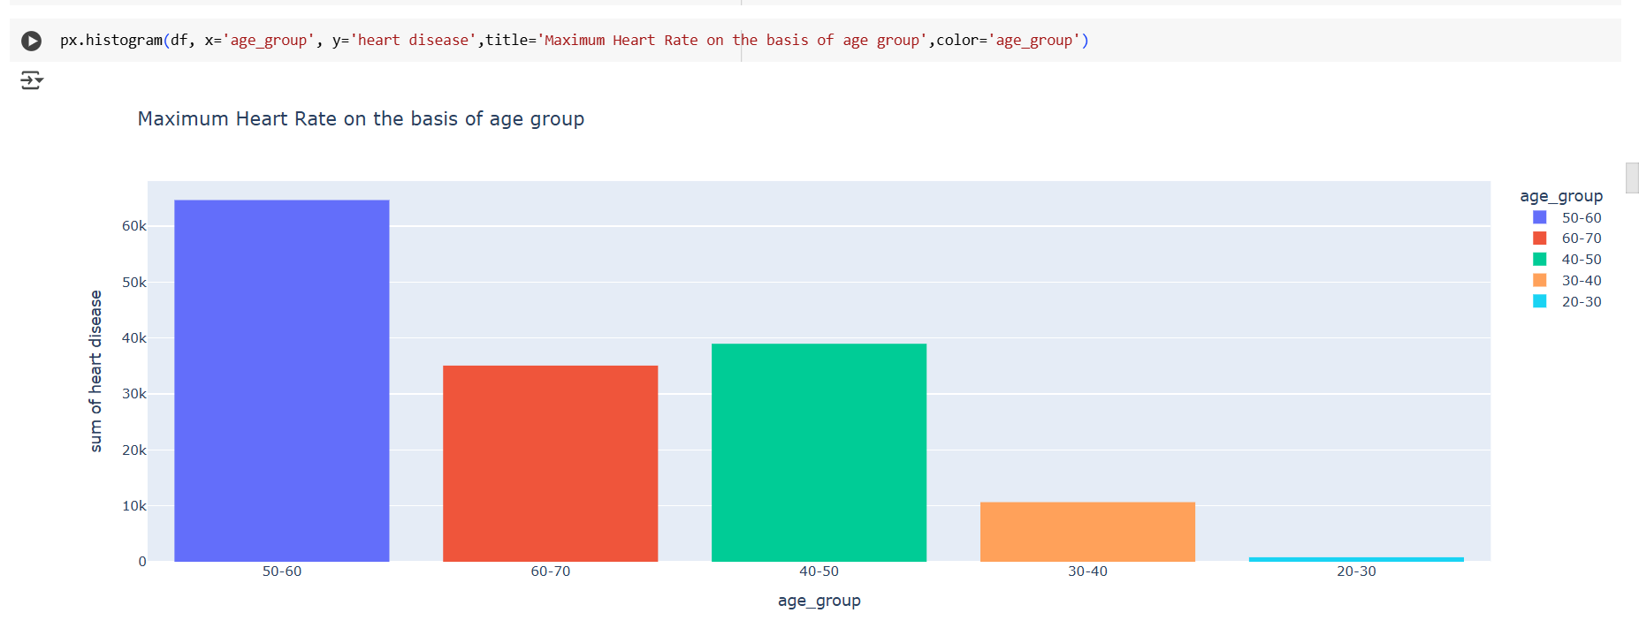
In the given figure that from the dataset where there are more than 1000 patient, converting into the age –group in the range of 10 (20-30). We can analysis that mostly the people from 50 to 60 age group people age affected from heart disease. After that 40-30,age group of people. Where we can conclude that mostly heart disease are being affected in adult age.

Slide 15
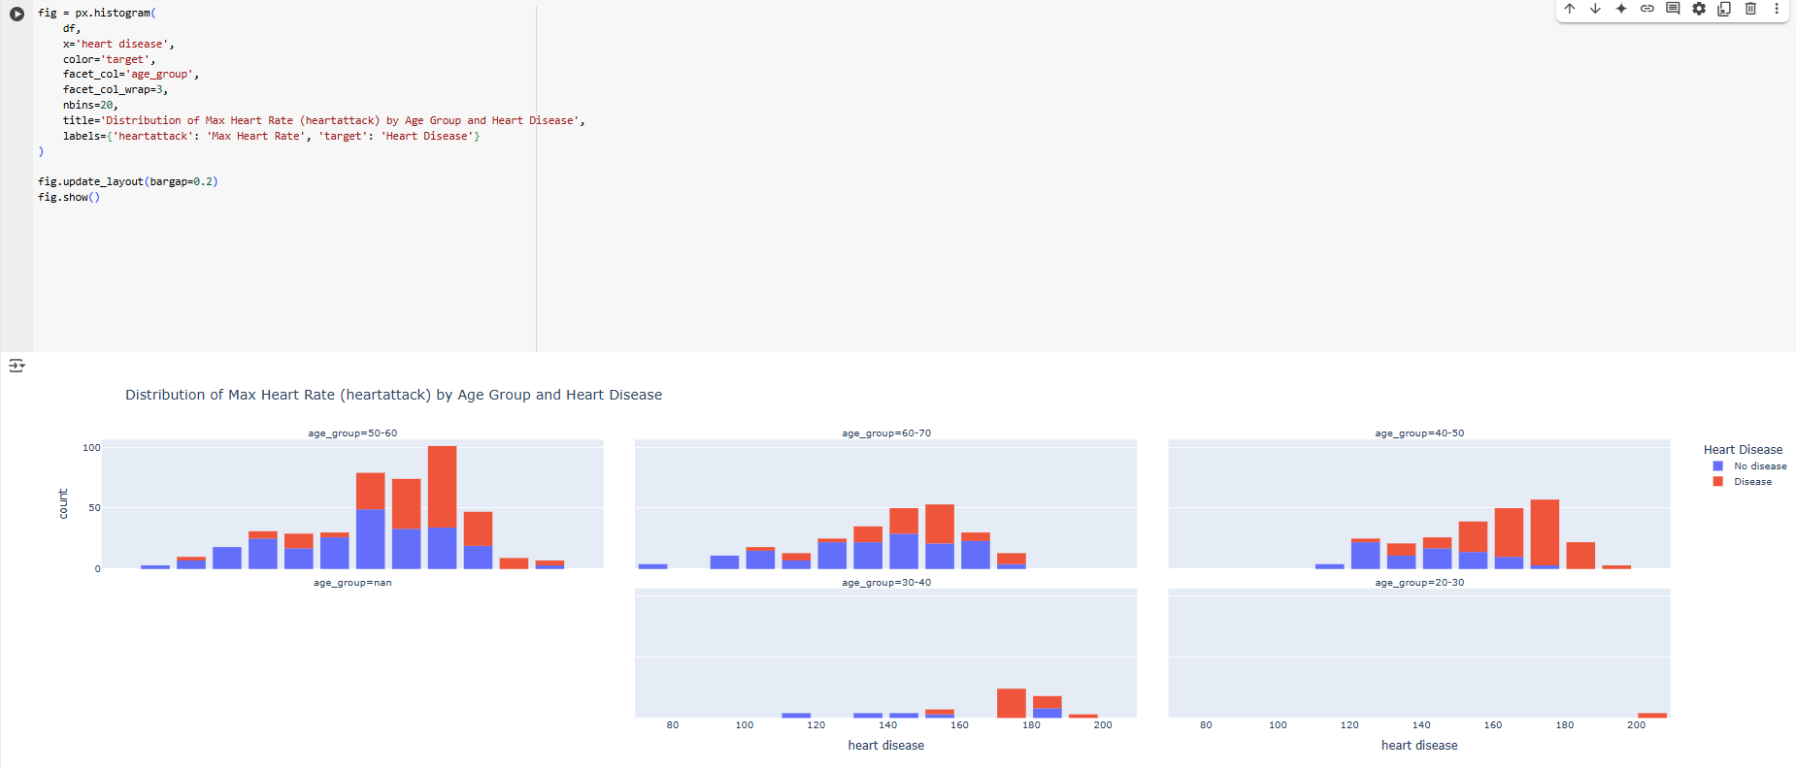

Slide 16
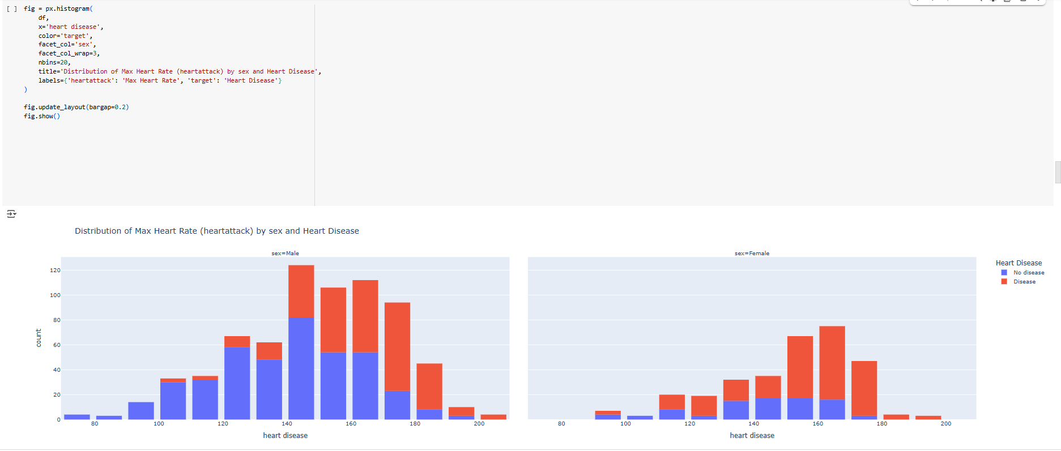

Slide 17
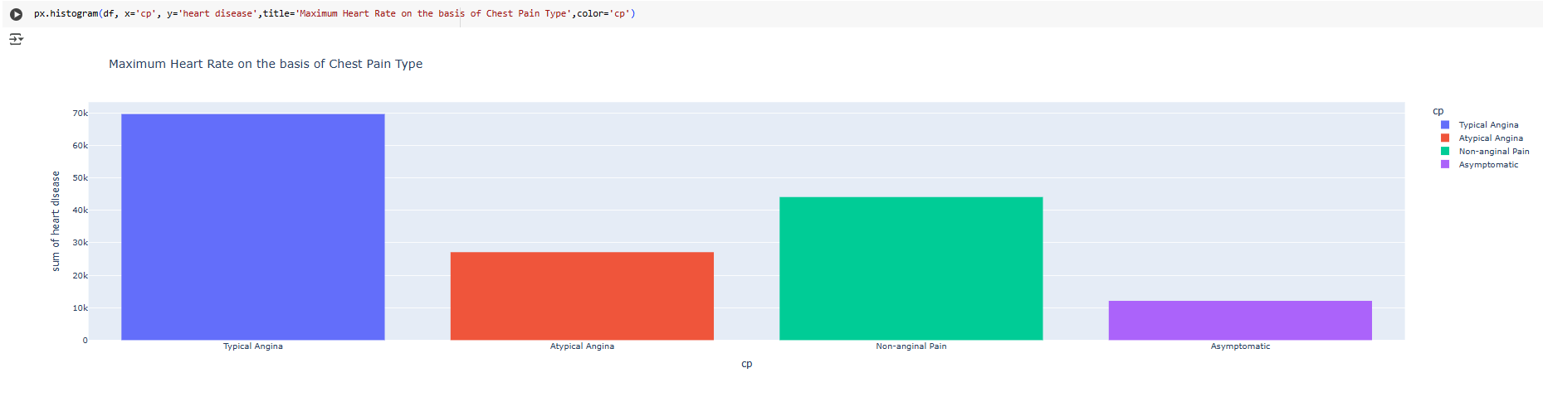
In this figure we can conclude that chest pain have four type. The high chance of the heart disease is mainly occurred in typical Angina.

Slide 19
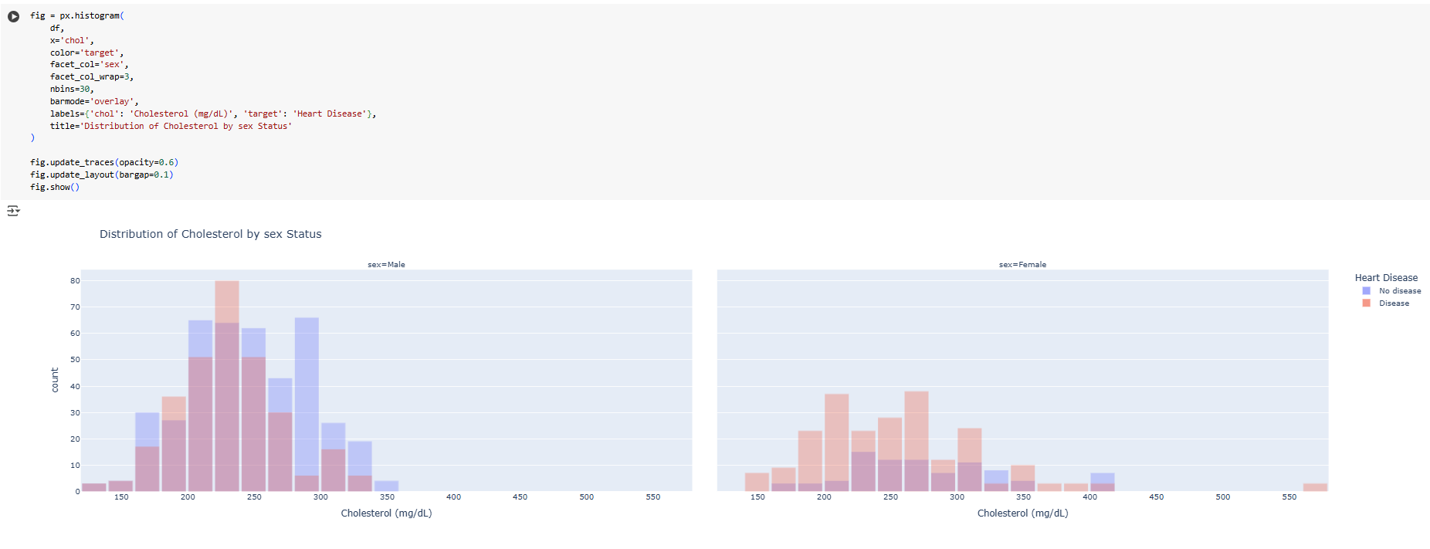

Slide 20
Form dataset of the above figure, cholesterol found more in female body than male body due to which let more affect the heart disease on female comprise to male. While analysis we can found that cholesterol is found in female body is more than 400mg/dl, where in male body we just found upto 300mg/dl

Slide 21
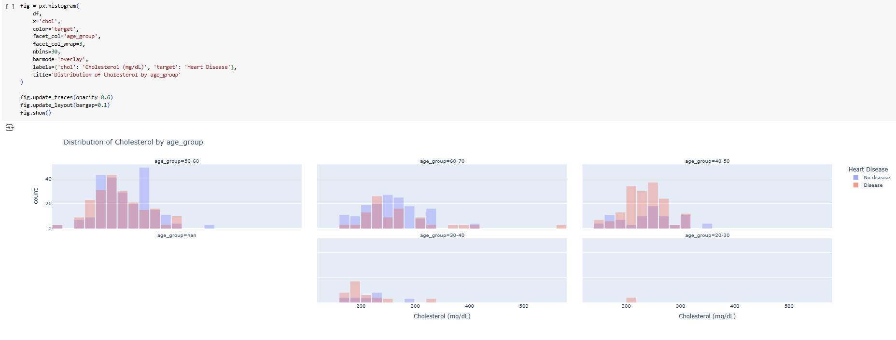

Slide 22
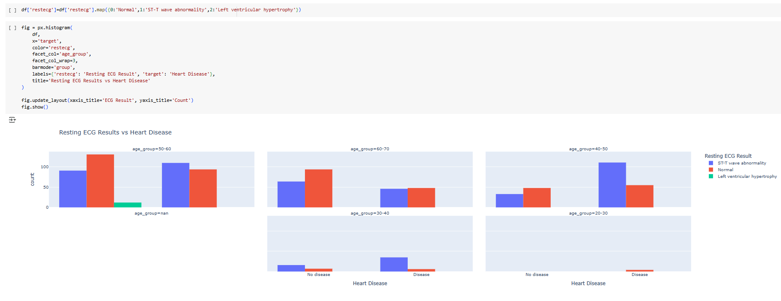

Slide 23
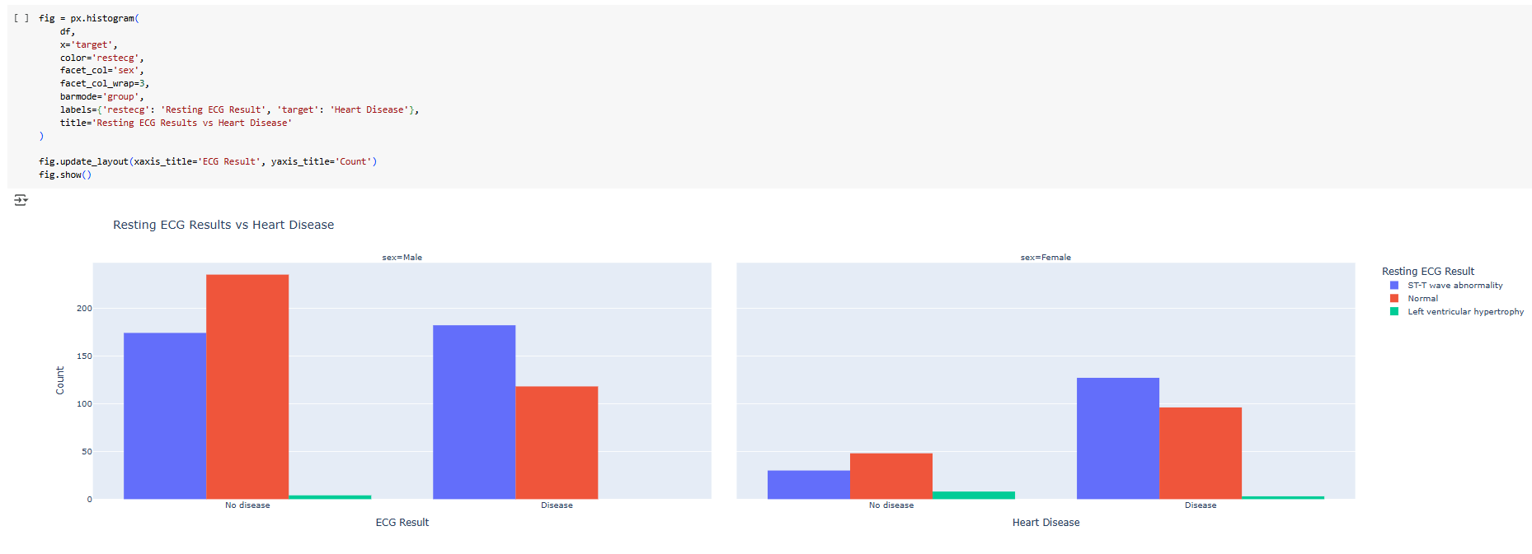

Slide 24
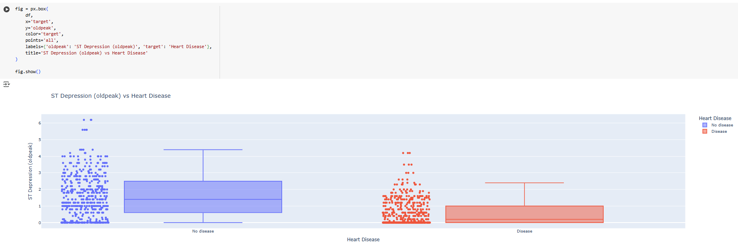

Slide 25
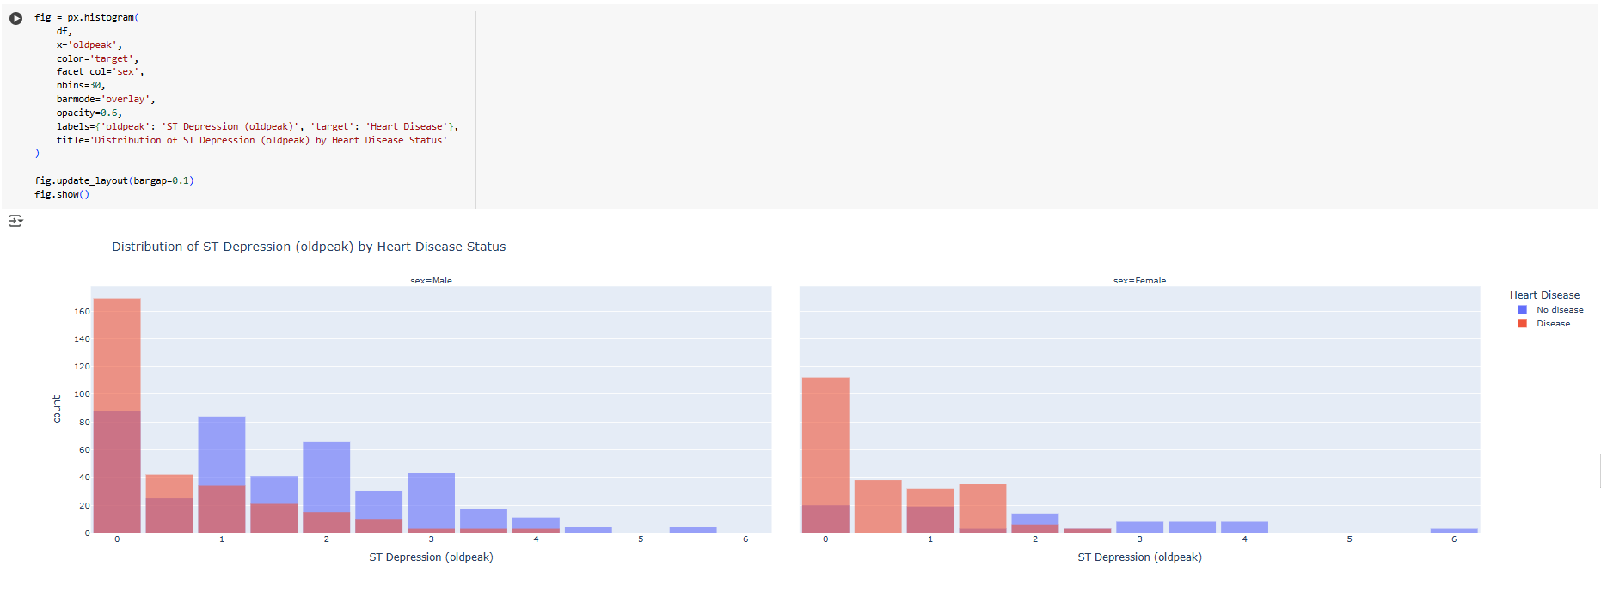

Slide 26
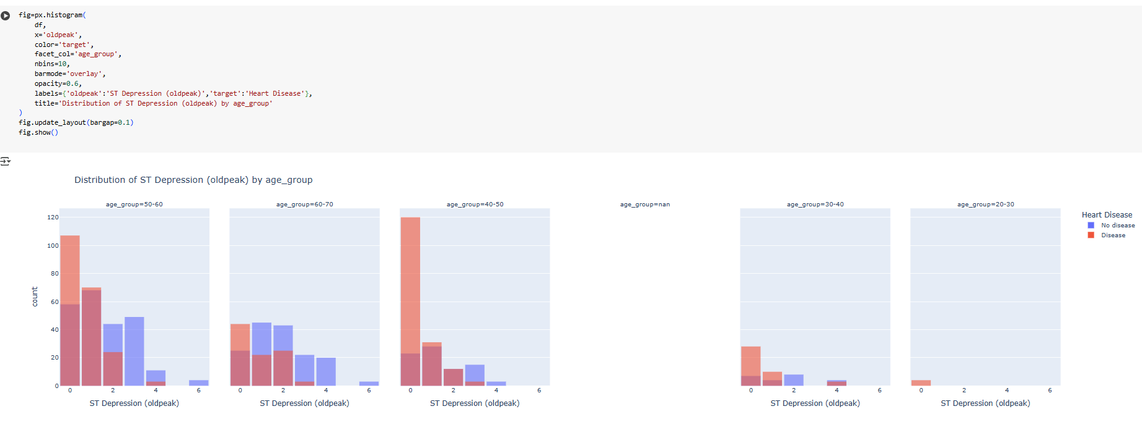

Slide 27
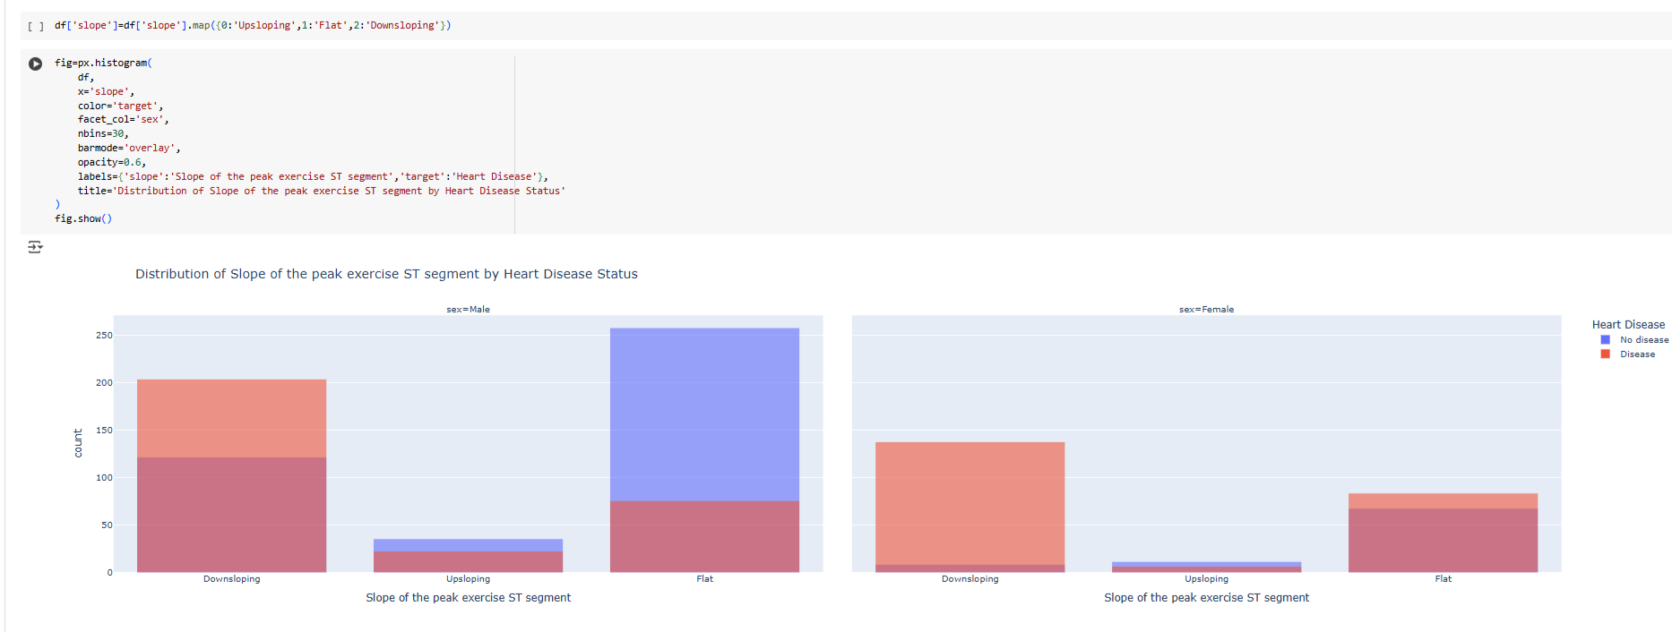

Slide 28
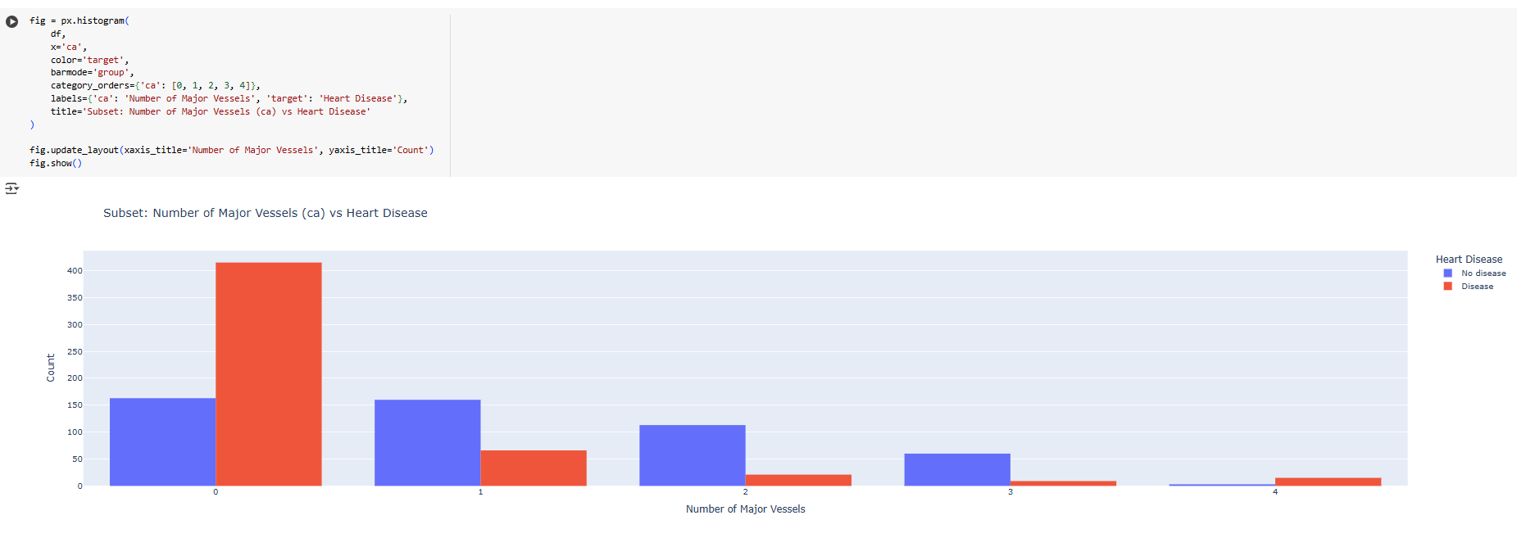

Slide 29

Conclusion
Heart disease is one of the most very dangerous disease. In this dataset there are more than 1000 of data with fourteen features. I had compared this dataset on the basis of sex and age group on the heart disease. While analysis the dataset, I had got Heart disease is can be affected through many reason. Such as due to chest pain (CP), cholesterol, fbs etc. one major thing is that this disease is mainly in the adult age group like 50-60 in maximum number. The main causes is chest pain after that fasting blood sugar. When we see the dataset that we can conclude in the compare between the male and female, male is victim of heart disease more than female. And in case of cp (chest pain) typical Angina pain suffer more from heart disease. And last cholesterol is also one of the major problem of heart disease. While analysing the dataset we found the chance of heart disease is high if the cholesterol is high. Additionally, the result of ECG we have found that heart beats of male is higher then female due to this cause heart disease. At last, I would like to say that in the overall the dataset mainly the health problem related to heart is high in male compares to the female.

Slide 30


